Slide 2
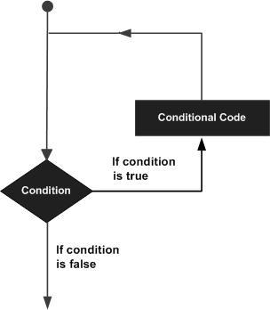
LOOPS
A loop statement allows us to execute a statement or group of statements multiple times.

Slide 3
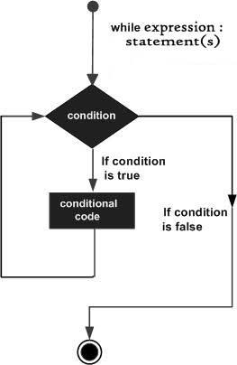
While Loop
A while loop statement is repeatedly executes a target statement as long as a given condition is true.
Syntax
while expression:
statement(s)

Slide 4
Program
#!/usr/bin/python
count = 0
while (count < 9):
print 'The count is:', count
count = count + 1
print "Good bye!"

Slide 5
The Infinite Loop
An infinite loop might be useful in client/server programming where the server needs to run continuously so that client programs can communicate with it as and when required.

Slide 6
Program
#!/usr/bin/python
var = 1
while var == 1 : # This constructs an infinite loop
num = raw_input("Enter a number :")
print "You entered: ", num
print "Good bye!"

Slide 7
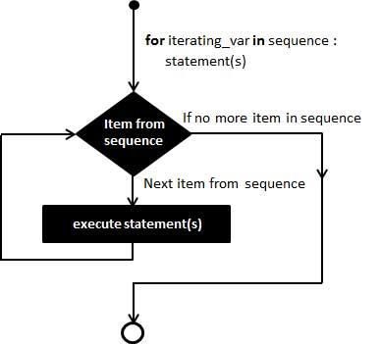
For Loop
It has the ability to iterate over the items of any sequence, such as a list or a string.
Syntax
for iterating_var in sequence:
statements(s)

Slide 8
Program
#!/usr/bin/python
for letter in 'Python': # First Example
print 'Current Letter :', letter
fruits = ['banana', 'apple', 'mango']
for fruit in fruits: # Second Example
print 'Current fruit :', fruit
print "Good bye!"

Slide 9
Nested Loops
Python programming language allows to use one loop inside another loop.
Syntax
for iterating_var in sequence:
for iterating_var in sequence:
statements(s)
statements(s)
nested while loop
while expression:
while expression:
statement(s)
statement(s)

Slide 10
Program
#!/usr/bin/python
i = 2
while(i < 100):
j = 2
while(j <= (i/j)):
if not(i%j): break
j = j + 1
if (j > i/j) : print i, " is prime"
i = i + 1
print "Good bye!"

Slide 11
Loop Control Statements
Loop control statements change execution from its normal sequence. When execution leaves a scope, all automatic objects that were created in that scope are destroyed.
Statements:
break statement
continue statement
pass statement

Slide 12
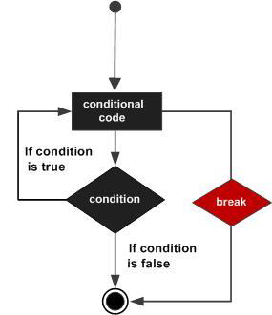
Break Statement
The most common use for break is when some external condition is triggered requiring a hasty exit from a loop.
The break statement can be used in both while and for loops.
Syntax
break

Slide 13
Program
#!/usr/bin/python
for letter in 'Python': # First Example
if letter == 'h':
break
print 'Current Letter :', letter
var = 10 # Second Example
while var > 0:
print 'Current variable value :', var
var = var -1
if var == 5:
break
print "Good bye!"

Slide 14
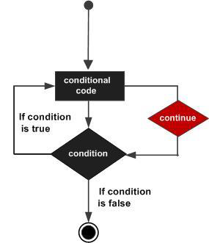
Continue Statement
The continue statement rejects all the remaining statements in the current iteration of the loop and moves the control back to the top of the loop.
The continue statement can be used in both while and for loops.
Syntax
continue

Slide 15
Program
#!/usr/bin/python
for letter in 'Python': # First Example
if letter == 'h':
continue
print 'Current Letter :', letter
var = 10 # Second Example
while var > 0:
var = var -1
if var == 5:
continue
print 'Current variable value :', var
print "Good bye!"

Slide 16
Pass Statement
The pass statement is a null operation; nothing happens when it executes.
Syntax
pass

Slide 17
Program
#!/usr/bin/python
for letter in 'Python':
if letter == 'h':
pass
print 'This is pass block'
print 'Current Letter :', letter
print "Good bye!"

